Slide 1

SVKM’s Institute of Technology, Dhule Department of Information Technology
Major Project Presentation​
On​
“Criminal Face Detection”
By
4 – Zaid Ansari
39 – Bhupendra Pawar
45 – Prathmesh Raghuvanshi
66– Chetan Khairnar
Guide
Prof. Sagar Badjate

Slide 2
Contents
Project Group
Project Motivation
Problem Statement
Project Abstract
Results and Impementation

Slide 3
Project Details
Project Title : “Criminal Face Detection”
Project Domain: Web Application
Project Group Members:
T2054491246063 , Zaid Ansari
T2054491246010 , Bhupendra Pawar
T2054491246040 , Prathmesh Raghuvanshi
T2154491246503 , Chetan Khairnar

Slide 4
Motivation
The motivation behind this project is to provide the ease to police personnel in order to find criminals from anywhere without wasting the time and cost. This application also helps to maintain records of criminals, one can also find all the details of the criminal in our application.
this technology can determine criminal activities, expedite investigations, and enable quicker responses to incidents.

Slide 5
Problem statement
This project aims to create a smart system that can recognize people with criminal records using their faces in surveillance videos. However, it's a bit tricky because we need to make sure the system doesn't unfairly treat some groups of people and also respects everyone's privacy. We want this technology to help make public places safer, but we need to be careful to do it in a fair and respectful way.

Slide 6
Aim
The aim of this project is to develop a system that can use cameras to identify individuals with criminal records from videos, making public spaces safer. It's important to ensure that the system treats everyone fairly and respects their privacy. By doing this, we hope to assist law enforcement in their work while upholding ethical standards and avoiding any biases.

Slide 7
Abstract
This project focuses on creating a computer-based system that can spot people with criminal records from video footage, like security camera recordings. We want this system to make places safer by helping the police identify potential troublemakers. But, we're also careful to make sure it's fair and doesn't invade anyone's privacy. This technology could improve how law enforcement works while treating everyone equally.

Slide 8
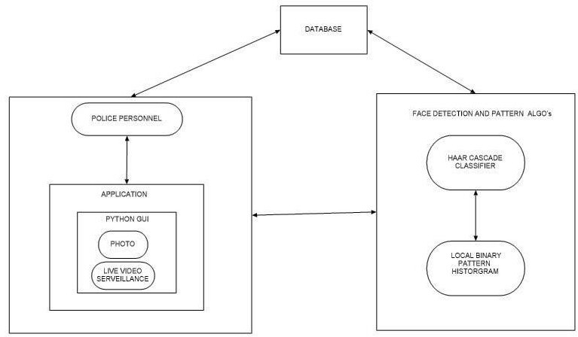
ARCHITECTURE

Slide 9
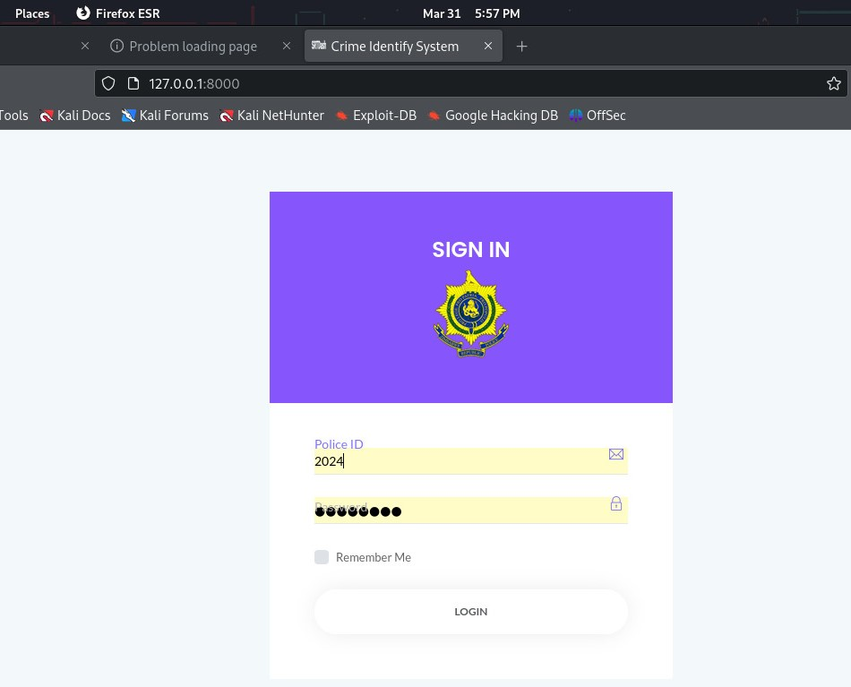
RESULTS

Slide 10

RESULTS

Slide 11

RESULTS

Slide 12
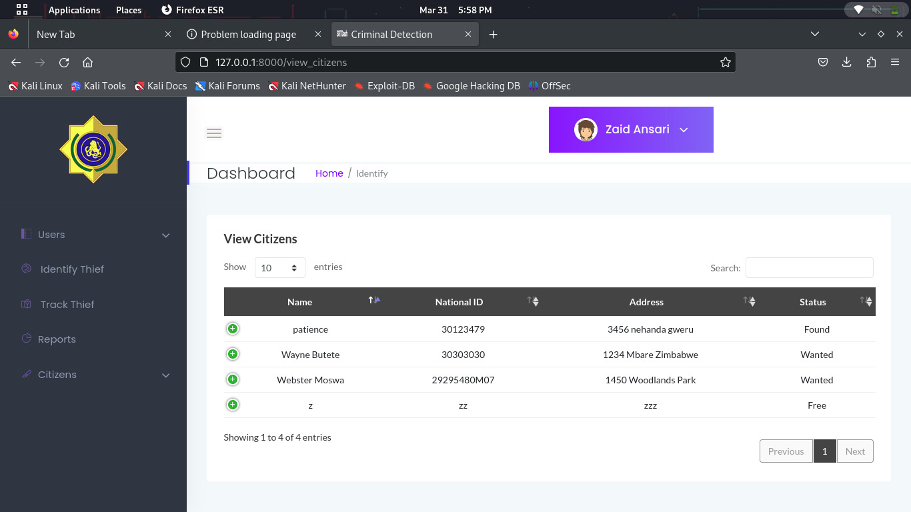
RESULTS

Slide 13
References
[1]Lamiaa A. Elrefaei1,2, Alaa Alharthi1,Huda Alamoudi1,Shatha Almutairi1,and Fatima Al-rammah Real-time Face Detection and Tracking on Mobile Phones for Criminal Detection .2nd International Conference on Anti-Cyber Crimes (ICACC) 26-27 March 2017
[2]W. Yimyam, T. Pinthong, N. Chumuang and M. Ketcham, "Face Detection Criminals through Cameras," 2018 14th International Conference on Signal-Image Technology & Internet-Based Systems (SITIS), Las Palmas de Gran Canaria, Spain, 2018, pp. 351-357, doi: 10.1109/SITIS.2018.00061.
[3]S. Jagtap, N. B. Chopade and S. Tungar, "An Investigation of Face Recognition System for Criminal Identification in Surveillance Video," 2022 6th International Conference On Computing, Communication, Control And Automation (ICCUBEA, Pune, India, 2022, pp. 1-5, doi: 10.1109/ICCUBEA54992.2022.10010987.
[4]S. T. Ratnaparkhi, P. Singh, A. Tandasi and N. Sindhwani, "Comparative Analysis of Classifiers for Criminal Identification System Using Face Recognition," 2021 9th International Conference on Reliability, Infocom Technologies and Optimization (Trends and Future Directions) (ICRITO), Noida, India, 2021, pp. 1-6, doi: 10.1109/ICRITO51393.2021.9596066.

Slide 14
References
[5] K. P. Teja, G. D. Kumar and T. P. Jacob, "Face Detection and Recognition for Criminal Identification," 2023 8th International Conference on Communication and Electronics Systems (ICCES), Coimbatore, India, 2023, pp. 1431-1435, doi: 10.1109/ICCES57224.2023.10192845.
[6]J. Dhamija, T. Choudhury, P. Kumar and Y. S. Rathore, "An Advancement towards Efficient Face Recognition Using Live Video Feed: "For the Future"," 2017 3rd International Conference on Computational Intelligence and Networks (CINE), Odisha, India, 2017, pp. 53-56, doi: 10.1109/CINE.2017.21.
[7] D. -Y. Huang, C. -H. Chen, T. -Y. Chen, J. -H. Wu and C. -C. Ko, "Real-Time Face Detection Using a Moving Camera," 2018 32nd International Conference on Advanced Information Networking and Applications Workshops (WAINA), Krakow, Poland, 2018, pp. 609-614, doi: 10.1109/WAINA.2018.00153.
[8] S. T. Ratnaparkhi, A. Tandasi and S. Saraswat, "Face Detection and Recognition for Criminal Identification System," 2021 11th International Conference on Cloud Computing, Data Science & Engineering (Confluence), Noida, India, 2021, pp. 773-777, doi: 1109/Confluence51648.2021.9377205.

Slide 15
THANK YOU…!!

